Slide 1
EU INSTITUTIONS: A GENERAL FRAMEWORK
Dott. Leonardo Pasqui
Dipartimento di Sociologia e Diritto dell’Economia
Jean Monnet Module «EULA – EU law for Algorithm»

Slide 2
Introduction
What is the nature of the European Union?
- EU is not a State or a federation of States.
All EU powers are delegated by the Member States
There are not EU people, but EU citizenship is additional to the national one.
EU is a supranational organization. Its legal basis are the Treaties of the EU, which define the EU competences → principle of conferral.

Slide 3
Main institutions
The institutions we will see today are:
European Commission
European Council
Council of Europe
European Parliament
European Court of Justice

Slide 4
European Commission
Art. 17 TEU: The Commission shall promote the general interest of the Union and take appropriate initiatives to that end. It shall ensure the application of the Treaties, and of measures adopted by the institutions pursuant to them.
The Commission has 27 members, one for each Member States, and they are appointed for a period of 5 years.
The President of the Commission is nominated by the European Council by common accord, but he/she has to be voted by the European Parliament too.
After the election of the President, the other Commissioners are then appointed, on the basis of Member States’ proposals, by agreement with the Commission President, by a qualified majority vote of the European Council and the approval of the European Parliament.

Slide 5
European Commission - Powers
The President lays down the general guidelines of the work, appoints one or more vice-presidents.
These Vice-Presidents are in addition to the High Representative for the EU’s foreign policy, who is
always a Vice-President.
The Commission is the only institution with the right of initiative, namely propose new laws. However, it doesn’t have the legislative power.
Furthermore, the Commission is the Guardian of the Treaties: accordingly, it has the right to take infringement actions against Member States which have not met their obligations under EU law.
The Commission has the role for administering the EU’s budget and deciding how the budget is spent within the EU Member States→ NEXT GENERATION EU
The Commission has also the sole competence to negotiate international treaties on behalf of the EU role of High Representative of the Union for Foreign Affairs and Security Policy.

Slide 6
European Commission - Powers
Then, we can sum-up the Commission powers, as it follows:
promote the general interest of the EU and ‘take appropriate initiatives to that end;
ensure the application of the Treaties and measures giving effect to them;
oversee the application of EU law, subject to the Court of Justice;
execute the budget and manage programmes;
exercise coordinating, executive and management functions;
ensure the Union's external representation, except as regards EU foreign policy
initiate the Union's annual and multi-annual programming.

Slide 7
European Parliament
Since 1979 the European Parliament is elected directly by European Union citizens through democratic election held every 5 years in every Member State.
It has 751 members, divided proportionally by each State→ Germany elects 96 MEP, while Malta only 6.
It has three different seats: one in Strasbourg for monthly plenary sessions, committee meetings in Brussels and its Scretariat in Luxemburg.
European Parliament is elected every 5 years by the EU citizens. Currently, we are in the legislation 2019-2024.

Slide 8
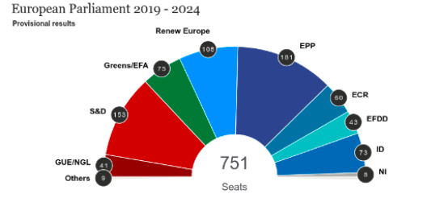
European Parliament - Composition

Slide 9
European Parliament
The European Parliament has three main roles:
Legislative role: The Parliament has different levels of participating during th legilative process.
Budgetary role: the European parliament has to approve the budget of the European Union.
Supervisory role: the Parliament has certain control powers.
Set up Commissions of Inquiry
Challenge actions by other EU institutions in front of the CJEU
Right to ask questions to the Commission
Ask the Commission to resign en bloc

Slide 10
European Parliament – Legislative role
The Treaty of Lisbon (in force 2009) expanded the use of the codecision procedure, renaming it the ‘ordinary legislative procedure’ and specifying that a number of residual cases with different rules for adopting legislative acts had to be regarded as ‘special legislative procedures.”
Although most special legislative procedures entail consultation of the European Parliament only, in some cases it has the power of consent; that is, it can veto the proposal in question.

Slide 11
Council of the EU
The Council is the EU’s main decision-making organ, although to a large extent it now shares this role with the European Parliament.
It is usually made up of ministers from Member States’ governments, so unsurprisingly it is one of the most ‘intergovernmental’ institutions (an institution dominated by Member States’ governments).
As noted already, the Council is, to a certain extent, comparable to the upper chamber of a two-chamber legislative system. In particular, it can be compared to the upper chamber in countries such as Germany (the Bundestag) and the US (the Senate), where membership of the chamber is directly linked to the division of the country into Lander (Germany) or states (the US).

Slide 12
Council of the EU
The Council does not have a fixed membership. Rather, it is made up of different ministers depending on the subject matter being discussed.
In comparison to the other EU institutions, the Council represents national interests. The ministers in the Council are responsible to their national governments.
The Council has three voting mechanisms:
Simple majority (14 Member States in favor)
Qualified majority (55% of Member States in favor, representing 65% of the EU population)
Unanimous vote (100% of Member States in favor)

Slide 13
Council of the EU
A key feature of the functioning of the Council is its Presidency.
The Presidency is held by each Member State in turn for a period of six months. The Presidency is nominally held by groups of three Member States working together; these groups are chosen on the basis of their ‘diversity and geographical balance’.
This means that each group of three contains a large, medium, and small State, and States from different parts of the EU.
Holding the Presidency means that the Member State is responsible for scheduling and chairing all of the Council meetings planned for the six-month period (except for the Foreign Affairs Council), as well as the meetings of the Council's preparatory bodies.

Slide 14
European Council
The European Council is composed by the Head of States or governments of the EU Member States.
Since the Treaty of Lisbon, the European Council is recognized as an EU institution. The Head of States are joined by the president of the Commission and in some instances by the High Representative.
The European Council doesn’t have legislative functions, but it can provide an agreement where such agreement was not possibile on a lower level.
The Treaty of Lisbon created the post of President of the European Council, which replaced this rotation system. The President is appointed by the European Council for two-and-a-half years, renewable once, by a qualified majority vote; there is no role for any other EU institution (or the general public) in his or her appointment.

Slide 15
European Council
Despite its informal basis, the European Council quickly became the main venue for discussing and deciding upon the key issues facing the EU, such as enlargement, budget disputes, Treaty amendments, high-profile external relations issues, and major political initiatives.
It met at least twice a year and, until the Treaty of Lisbon, the Presidency of the European Council matched the Presidency of the Council.
The European Council also retained its power to decide on sanctions against Member States and to adopt strategic foreign policy decisions and a decision establishing a common defence.
Its role in giving general guidance (as distinct from binding decisions) has also been retained, as regards the discussion of economic policy guidelines, its involvement in the adoption of the euro by more Member States, and the adoption of conclusions on the employment situation.

Slide 16
European Court of Justice
The Court of Justice of the European Union is the judicial organ of the Union, entrusted with the task of upholding the rule of law.
In the performance of this mandate, the Court reviews, in particular, the legality of the acts and omissions of Member States and of the EU institutions and interprets EU law at the request of the national courts.
The CJEU consists of two major courts:
The Court of Justice: composed by 27 judges and 11 adovates general
The General Court: composed by 54 judges

Slide 17
European Court of Justice
The Advocates General deliver impartial and independent Opinions in cases that raise new points of law.
The Advocates General are members of the Court, but their Opinions reflect their personal views on how a case should be decided and the freedom that they enjoy stands in contrast with the constraints to achieve consensus under which the judges operate.
While the Opinions are not legally binding on the Court, they provide invaluable assistance in the analysis of cases and have been extremely influential in the development of EU law.

Slide 18
European Court of Justice
The Court generally sits in chambers of three or five judges, but may sit in a Grand Chamber of 15 judges when a Member State or an institution of the Union, that is party to the proceedings, so requests or depending on the importance or difficulty of a case.
More unusually, it may sit as a Full Court in a number of cases provided in the Treaties and where it considers that a case is of exceptional importance.
There are no Advocates General attached to the General Court, but members of this Court may be called upon to perform the role of Advocate General, a possibility that has been rarely used to date.
The General Court normally sits in chambers of three or five judges but may also exceptionally sit as a Grand Chamber, as a Full Court, or even be constituted by a single judge.

Slide 19
European Court of Justice
What has the Court of Justice done for me?

Slide 20
Other EU institutions
European Central bank: the primary objective of ECB is to maintain the price stability within the Eurozone. Furthermore, the ECB shall support the general economic policies in the Union with a view to contributing to the achievement of the objectives of the Union.
European Investment Bank: The task of the European Investment Bank shall be to contribute, by having recourse to the capital market and utilising its own resources, to the balanced and steady development of the internal market in the interest of the Union. For this purpose the Bank shall, operating on a non-profit- making basis, grant loans and give guarantees which facilitate the financing of the following projects in all sectors of the economy.

Slide 21
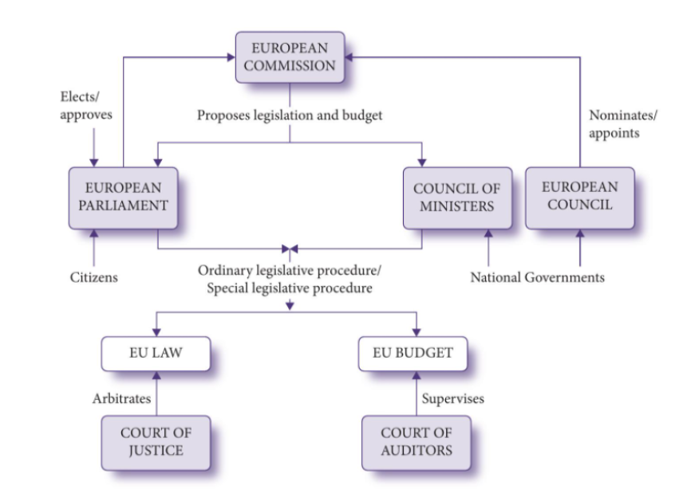
Recap

Slide 22
Dott. Leonardo Pasqui
leonardo.pasqui2@unibo.it

